Slide 1
5th Region F ICCWG meeting
Cádiz – Wednesday 12th June 2019
Report to the 21st conference of MBSHC regionFcoord@shom.fr
Mediterranean and Black Seas Hydrographic Commission (MBSHC)

Slide 2
[ICC5-2] – Minutes of ICCWG-4
Action N° | Action | Responsible | Update
MBSHC20/08 | Member States and Associate members to ensure that the information on any requirements for ECDIS back-up arrangements using paper charts have been posted on the IHO website, and to update or give confirmation of no change at least once a year. | All | Permanent. Updates received from : GB, GR, HR, IT, RO, TN, UA
MBSHC20/15 | To liaise with INToGIS Management team (IHO Secretariat) to retrieve their national account access details. | DZ, EG, MA, ME, SI, SY, TN | Done for DZ, EG, MA & TN
MBSHC20/16 | EG to propose a transition plan including procedure for reprint agreement prior to endorsement in the region F catalogue. | EG in liaison with UK | EG and GB are actively working on the development of this transition plan, no issue raised.

Slide 3
[ICC5-3] – Region F INT Scheme
Action N° | Action | Responsible | Update
MBSHC20/32 | New INT chart producers to provide Region F ICC and IHO Secretariat with the INT charts iaw IRCC7 Decision3 and Region F ICCWG ROPs section 3.11. | New INT producers | INT 3871 (GE101), INT3872 (GE102), INT3873 (GE103) and INT3876 (GE104) received 2019/05/30. Permanent action.
MBSHC20/35 | MS to check and, if necessary, update their INT charts metadata (chart limit, title, year, format, scale, etc.) included in the region F INT catalogue using their INToGIS national account. | INT producers | Updates received from DZ, ES, FR, GB, GE, HR, UA

Slide 4
[ICC5-3] – Region F INT Scheme : status
➔ New version of the catalog v3.0.6 June 2019
Current catalog : 306 INT Charts
220 Produced & 86 Schemed
 | Produced | Schemed
Overview | 15 | 0
General | 3 | 2
Coastal | 47 | 38
Approach | 45 | 11
Harbour | 91 | 27
Berthing | 19 | 8
Catalog v3.0.6 June 2019

Slide 5
[ICC5-3] – Region F INT Scheme : proposals
Action N° | Action | Responsible | Update
MBSHC20/36 | MS to submit their new INT chart proposals using their INToGIS national account. | INT producers | Proposals received from GR (Region F ICCWG CL 01 & 02/2019) & EG (MBSHC20/15)
Proposed MBSHC action :
EG to provide proposals of INT charts to the Region F ICC, to check consistency with the current INT scheme (new charts to be added to the scheme and charts taking over already produced INT charts, IAW with transition plan with UKHO, with justification of proposed modifications to the existing scheme if applicable)

Slide 6
[ICC5-3] – Region F INT Scheme
Proposal to update the Region F INT scheme in Aegean sea
9 new INT charts proposed by GR
Strong objection from TR, based on matters of disputed jurisdiction over some water areas.
The Coordinator’s view is that the issues raised are of a non technical nature (see ROPs section 3.7), and recommends that the MBSHC should approve the proposal of introducing those charts in the scheme, and assign production to GR, except for INT3736 in the South-East corner, to be assigned to GR & TR

Slide 7
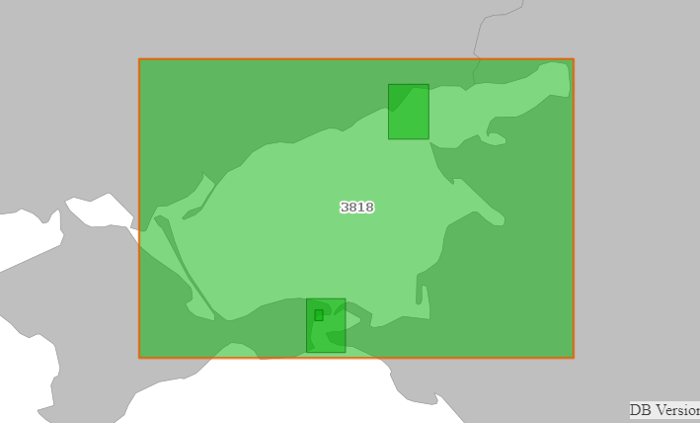
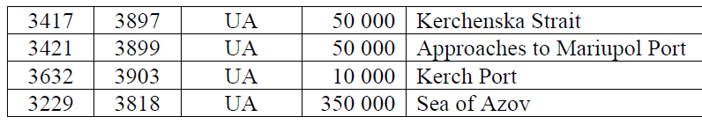
[ICC5-3] – Region F INT Scheme
INT scheme in the Black and Azov Seas – Pending charts
Request from UA to produce 4 INT Charts
  No agreement between RU and UA about production of these charts.
The Coordinator recommends that these charts, submitted by UA in INToGIS should be left pending until UA and RU reach an agreement
INT3818
INT3899
INT3897
INT3903

Slide 8
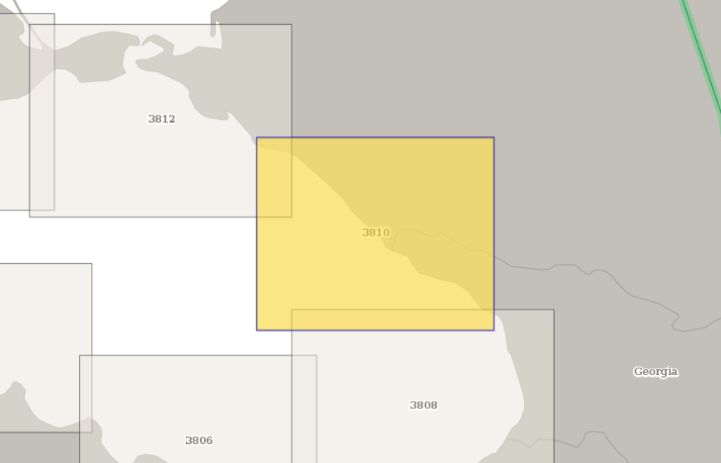
[ICC5-3] – Region F INT Scheme
INT scheme in the Black and Azov Seas – Pending charts
Request from GE to co-produce INT3810 with RU (INT3810 is currently produced by RU / RU32173)
RU and GE have still not reached an agreement on this chart
Proposed MBSHC action :
RU and GE to work on an agreement for the coproduction of INT3810 and report to the Region F ICC, who can provide help if needed.

Slide 9
[ICC5-3] – Region F INT Scheme
INT scheme in the Black and Azov Seas – Pending charts
Request from GE to produce the INT chart covering Soukhumi port with Approaches (GE108)
The interest of producing an INT chart for this port is weak (RU aborted production of a schemed INT chart in 2009)
The Coordinator’s view is that this chart should not be inserted in the INT scheme of the region.

Slide 10
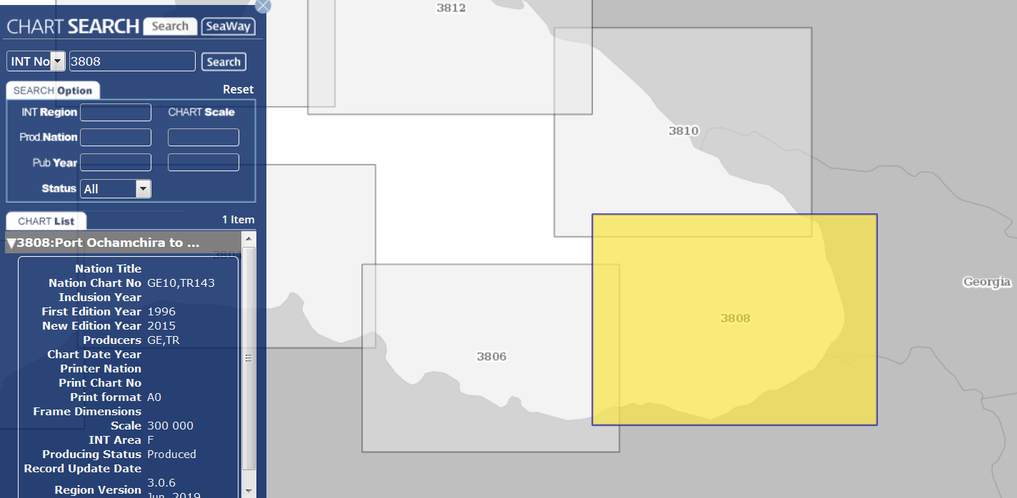
[ICC5-3] – Region F INT Scheme
INT3808 Chart (refer to RU national report)
Proposed MBSHC action :
RU to provide assigned producers (TR and GE) with repromats of their updated chart corresponding to INT3808 and with updating information for ENC TR200014

Slide 11
[ICC5-3] – Region F INT Scheme
Western Mediterranean INT Scheme (ES proposal)
Action N° | Action | Responsible | Update
MBSHC20/37 | ICCWG-F to confirm the transfer of INT3102, INT3108, INT3110 and INT3112 to the Western Mediterranean small scale INT scheme (see decision MBSHC20/06). | ICCWG-F | Transfer confirmed. These « General » charts will remain in the INT scheme after production of the schemed « Coastal » INT charts by ES.

Slide 12
[ICC5-4] – ENC coverage status
Action N° | Action | Responsible | Update
MBSHC20/17 | MS to use the IHO online port database to update their port priority list and report to the Regional Charting Coordinator (RCC). | All | Updates received from CY, DZ, ES, EG, FR, GB, GE, GR, HR, IT, RO and UA
MBSHC20/18 | RCC to disseminate an updated version of the Port priority list. | RCC | Report of the feedback received transmitted to the members of ICCWG, Sec IHO and NGA.
Proposed MBSHC action :
Make those actions permanent, updates to the Port priority list to be made on a regular basis, at least before each MBSHC meeting.

Slide 13
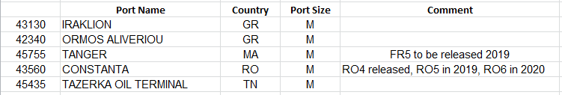
[ICC5-4] – ENC coverage status
UB1 and UB2 coverage considered as completed
UB3 coverage with persistent gaps on the Southern shore of the Mediterranean Sea
UB4/5/6 : still some ports from NGA World Port Index (Pub150) not covered
eg. 5 medium ports :
Source : PRIMAR Chart Catalogue

Slide 14
[ICC5-4] – ENC coverage status
Report from ES on some issues in Gibraltar strait arrived late and couldn’t be analysed in detail :
  The issue raised on ENCs produced by FR/MA is of a technical nature and should be easily solved by consultation between ES, FR and MA (agreement on a common limit)
  The other issue is mainly of a non technical nature and cannot be addressed by the ICCWG (see ROPs section 3.7).
Source : PRIMAR Chart Catalogue

Slide 15
[ICC5-5] – ENC overlap risk assessment
Action N° | Action | Responsible | Update
MBSHC20/19 | Concerned MSs to liaise bilaterally to resolve ENC overlappings, keeping the MBSHC Chair informed. | IT, GR, TR & HR | Little progress noted. Actions undertaken by IT and HR to resolve overlaps, overlaps in the process of being resolved. No information received on possible actions taken by GR and TR to resolve the many overlaps affecting the region. Should be a permanent action for all ENCs producers.
MBSHC20/21 | RENCs to provide a template report in order to collect the evaluation of risk level on ENC overlaps from the MS in the frame of the WENDWG risk assessment experimentation. | RENCs | Latest version (WEND9) sent to all ICCWG Members
MBSHC20/22 | MS to use the RENCs’ template report to provide the RCC with: evaluation of risk level on the most critical ENC overlaps based on the IC-ENC risk assessment regional database (level: MEDIUM); their views and comments on the IC-ENC risk assessment methodology. | All | Returns received from GB, GE, GR, IT, RO, SI, TR and UA

Slide 16
[ICC5-5] – ENC overlap risk assessment
IC-ENC Overlap report :
Persistent overlaps in Region F in all usage bands
March 18 > June 19
Resolved (and Acceptable) overlaps  :
Mechanisms put in place at the RENC level are working
Low & Medium overlaps persist
Potential overlaps 
Coordination between producers still insufficient
Region F | March 2018 | June 2019
Resolved | 36 | 71
Accept | 3 | 15
Potential | 37 | 50
LOW | 81 | 81
MEDIUM | 24 | 24
HIGH | 0 | 0
Total | 181 | 241

Slide 17
[ICC5-5] – ENC overlap risk assessment
IC-ENC Overlap report :
Persistent overlaps in Region F in all usage bands
Some good progress is made with ongoing agreements or discussion to solve overlap between GB/AL, IT/HR, IT/GR, GR/HR, RO/UA, GB/ME, GB/TN,…
But still several overlaps still with no move towards a solution, risk assessed Medium or Low by IC-ENC.

Slide 18
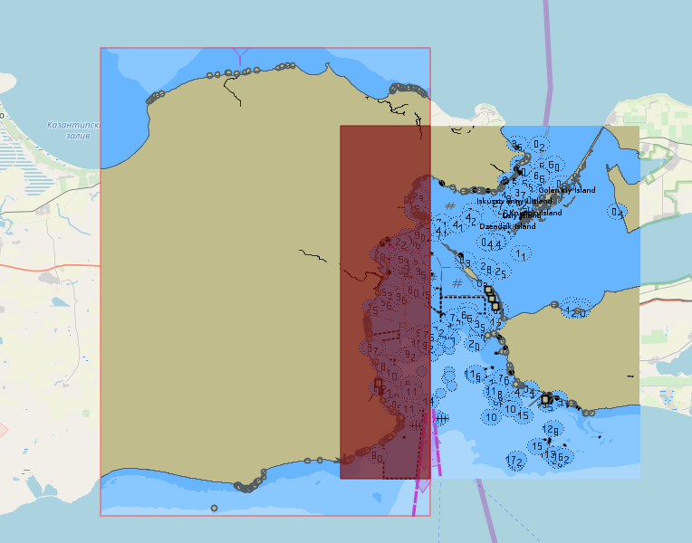
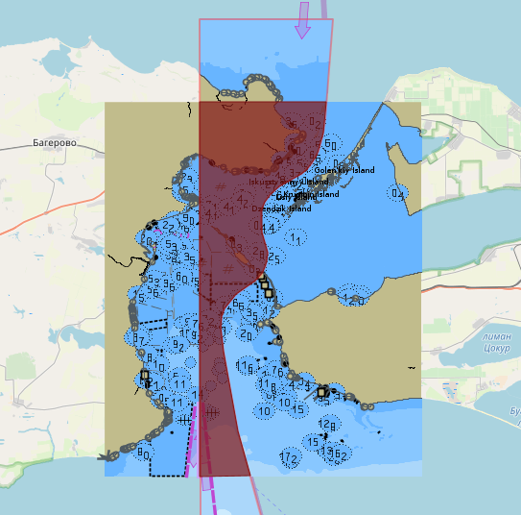
[ICC5-5] – ENC overlap risk assessment
RU4MFLJO & UA4CC883
Highest risk case :
Example :
RU4MFLJO & UA4CC883
RU4MFLJO & UA4CC884
IC-ENC Risk analysis ➔ Medium
But critical location of the overlap (main route through Kerch Straits & anchorage areas)
→ To be resolved
RU4MFLJO & UA4CC884

Slide 19
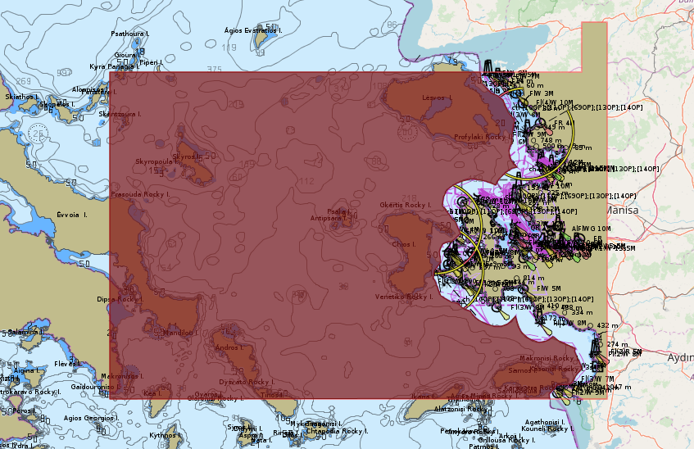
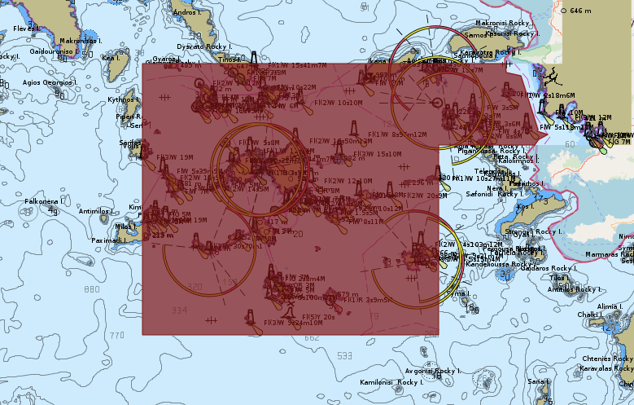
[ICC5-5] – ENC overlap risk assessment
GR2AF7UH & TR20022B
Highest risk case
Example :
GR2AF7UH & TR20022B
GR2AF7UH & TR20022A
IC-ENC Risk analysis ➔ Medium
GR analysis : High
TR analysis : Low
CC : high risk of inconsistency between cells due to lack of coordination between producers
→ To be resolved
GR2AF7UH & TR20022A

Slide 20
[ICC5-7] – Priorities for the ICCWG ?
What priorities for the ICCWG and the new ICC ?
  Continue updating the INT chart scheme or freeze the current scheme?
  Full implementation of the ENC scheme?
  Promotion of the S-100 series?
  The new ICC recommends that MBSHC should continue to foster dialogue between countries.
  One of the challenges being to set priorities on topics to be addressed within the framework of this dialogue.

Slide 21
[ICC5-8] – AOB & Closure
Documents concerning the group are collected on a restricted page of the commission's web page, which limits the diffusion of information
Proposed MBSHC action :
IHO Secretariat to put the documents (CL, Correspondence, Presentations) on an open access page of the commission and to keep only the archived versions of old catalogues on the restricted access page.

Slide 22
Action requested from the MBSHC
The MBSHC is invited to :
Take note of the 5th Region F ICCWG report
Include the proposed actions in the MBSHC21 action list
Consider the recommendations of the Region F International Charting Coordinator
Take any other action deemed appropriate.
6 – Coordination of Regional Charting

